Slide 1
THE MEME PRESENTATION
PROJECT #1
Notes:
•

Slide 2
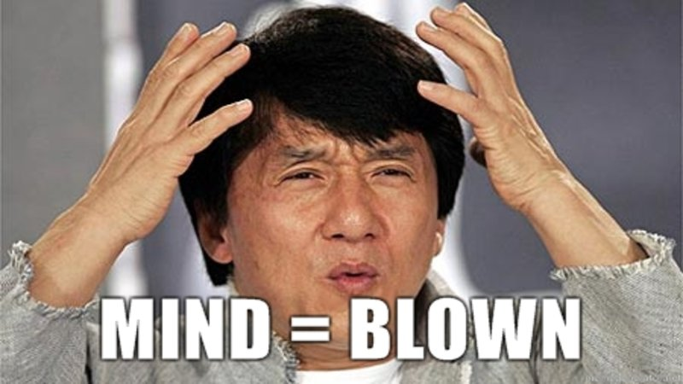
TOTAL RESULTS
MEME
TIME FRAME
INTEREST
POPULARITY

Slide 3

CORE HYPOTHESIS
Meme’s will follow a product life cycle curve, and more specifically, have a period of exponential growth followed by a period of exponential decay.

Slide 4
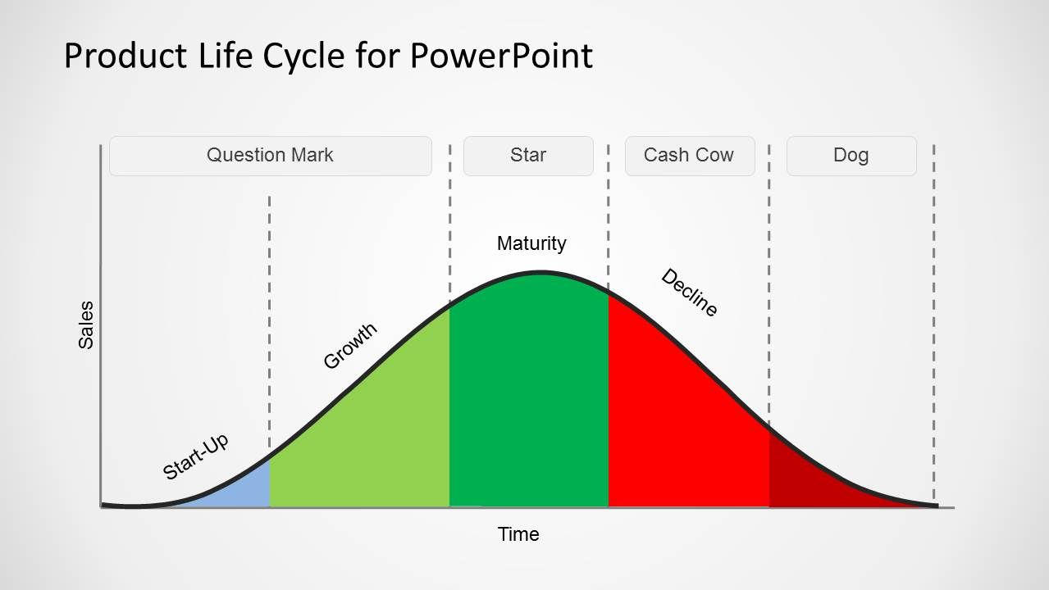

Slide 5
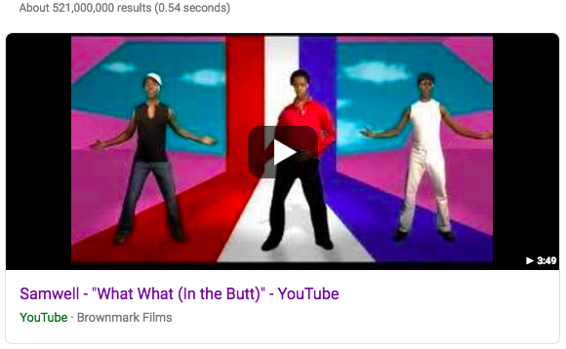
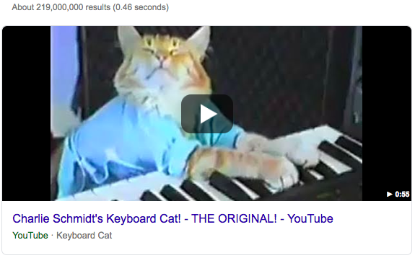
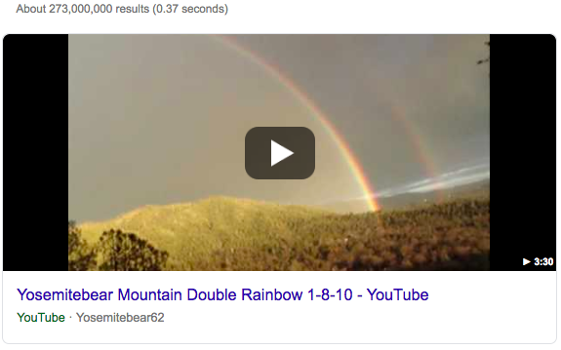
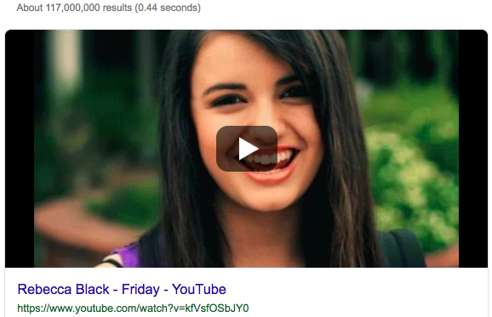
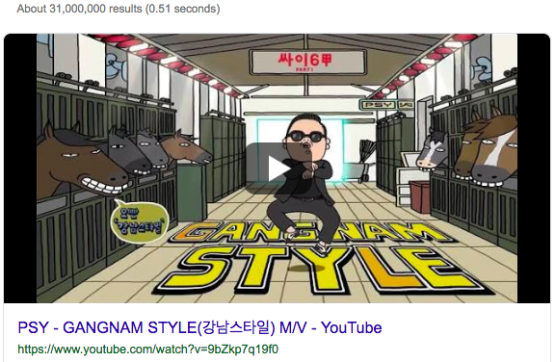
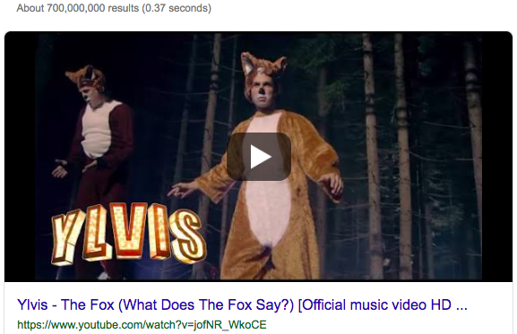
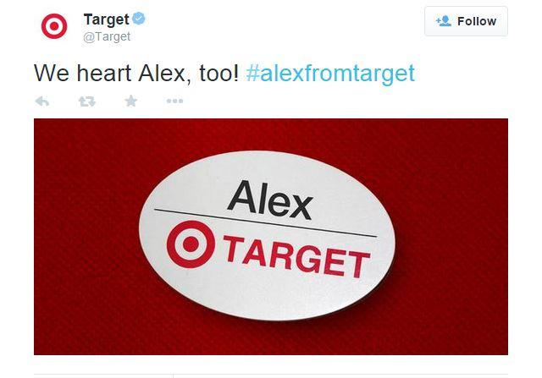
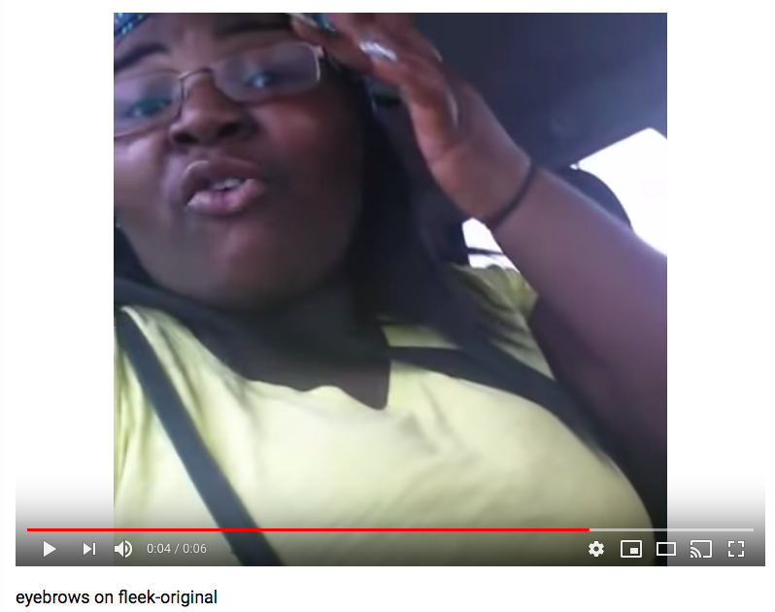
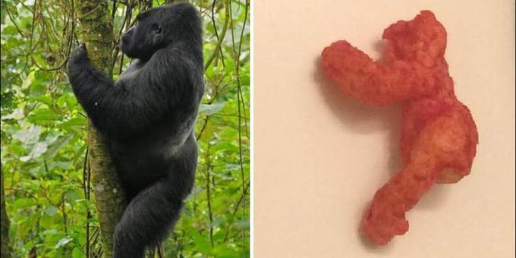
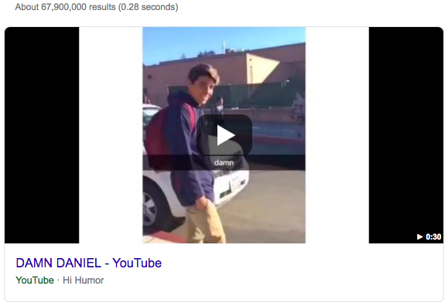

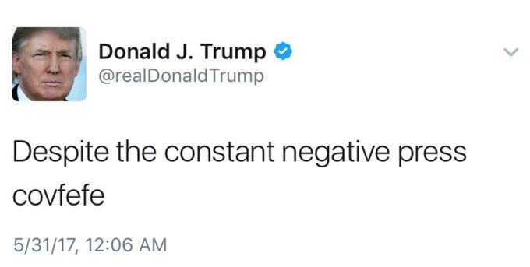
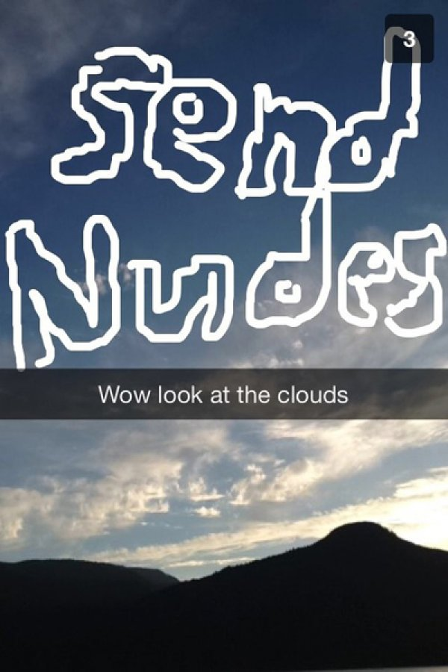
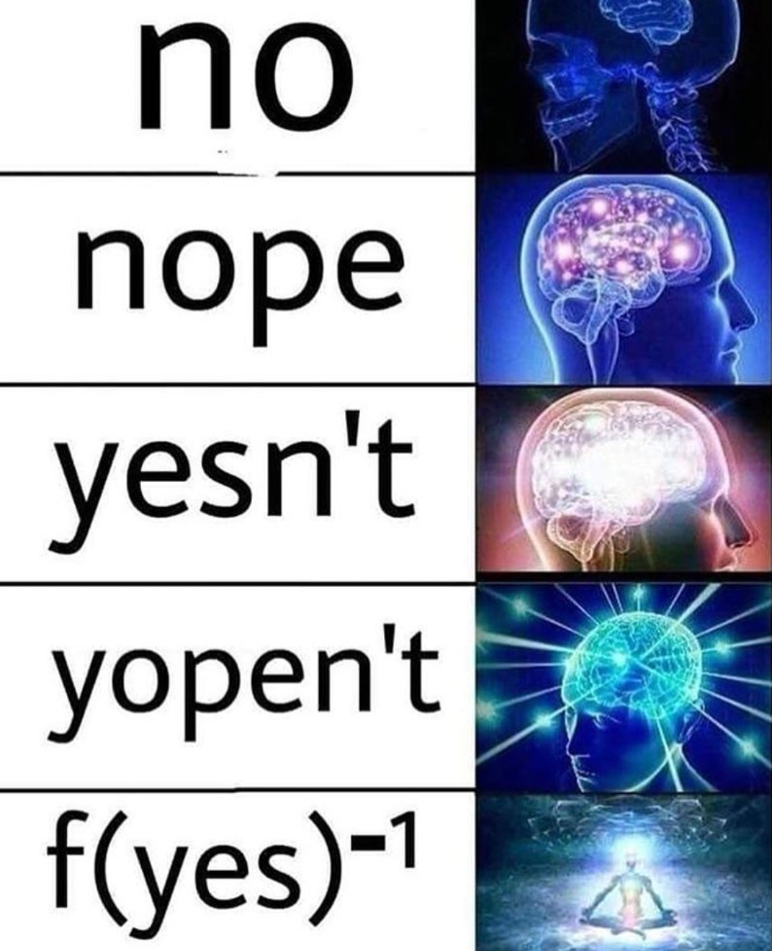
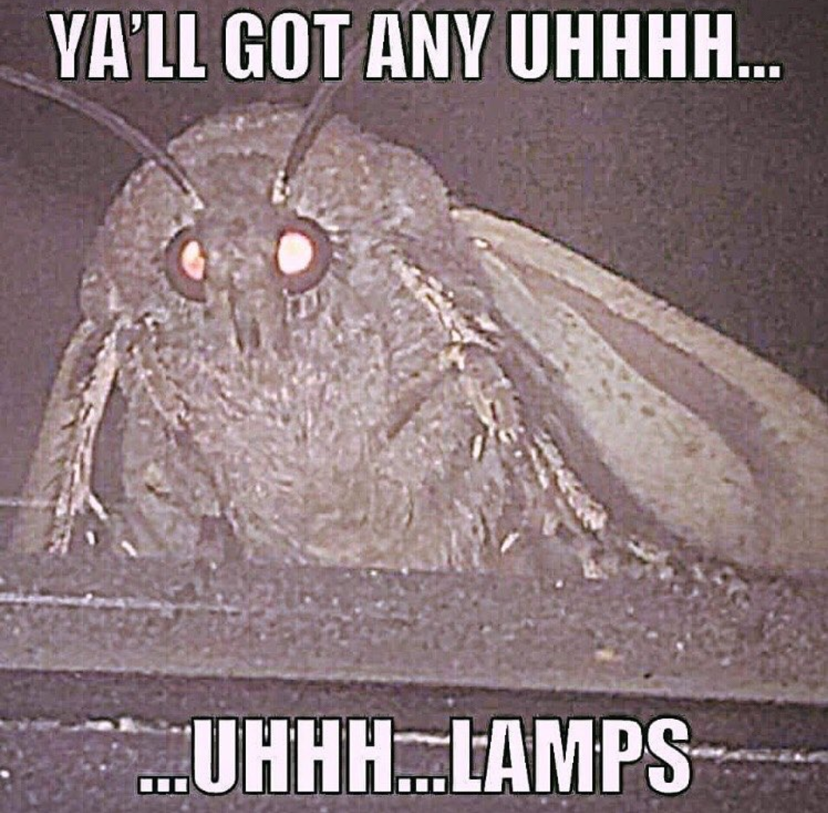
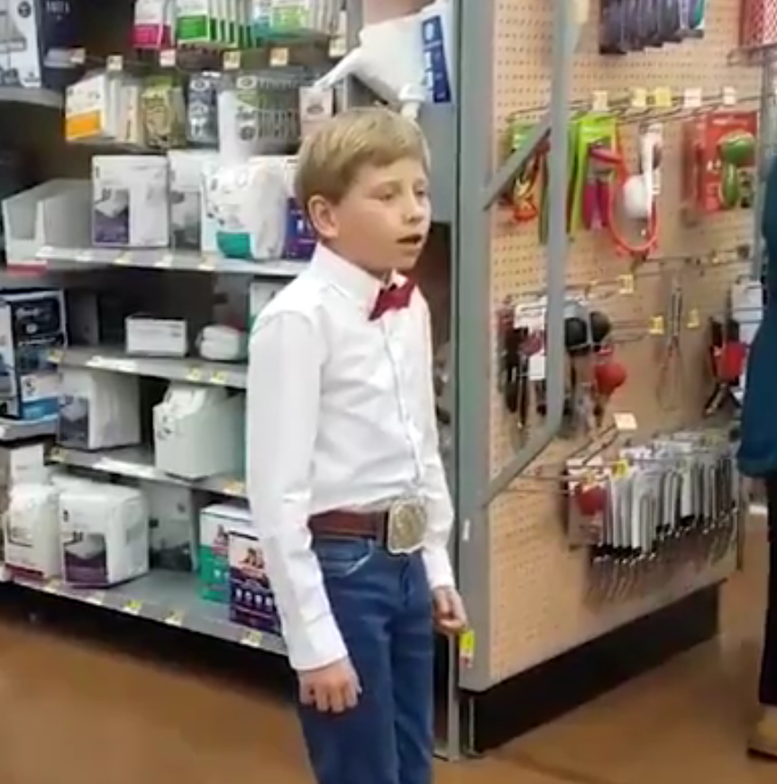
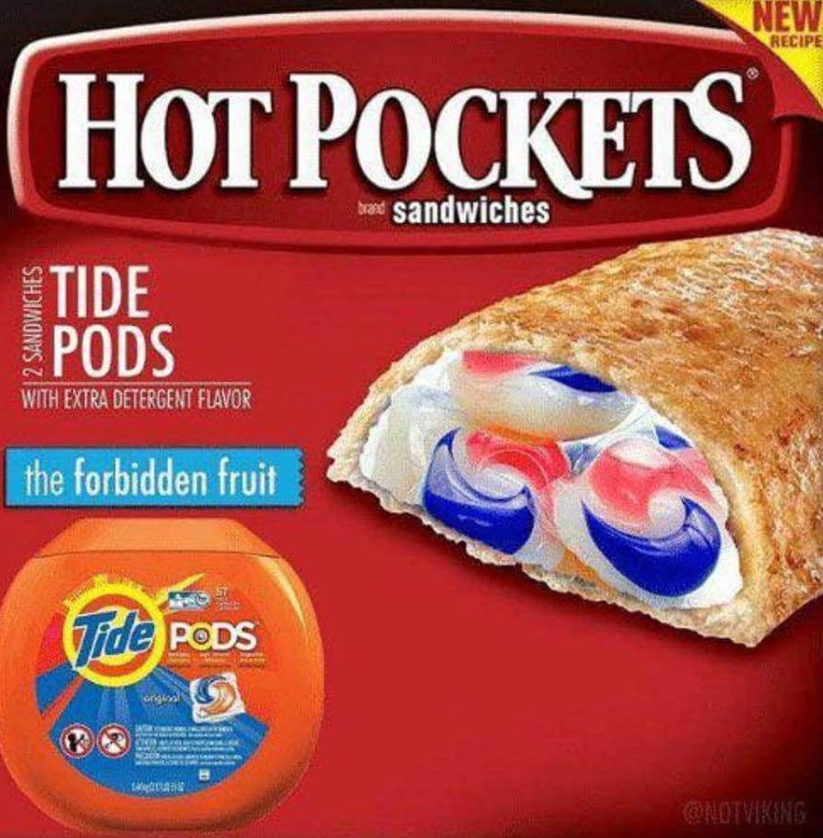
Hello...is it meme you’re lookin’ for?
2008
2009
2010
2011
2012
2013
2014
2015
2016
2016
2017
2018

Slide 6
Hello...is it meme you’re lookin’ for?
2018:
Moth Lamp meme
Yodelling Walmart Boy
Tide Pods meme
2017:
Covfefe
Send Nudes
Expanding Brain
2008-2015:
What What(In The Butt)
Keyboard Cat
Double Rainbow
Rebecca Black Friday
Gangnam Style
What Does The Fox Say
Alex From Target
On Fleek
2016:
Harambe
Damn Daniel
Pepe The Dog

Slide 7

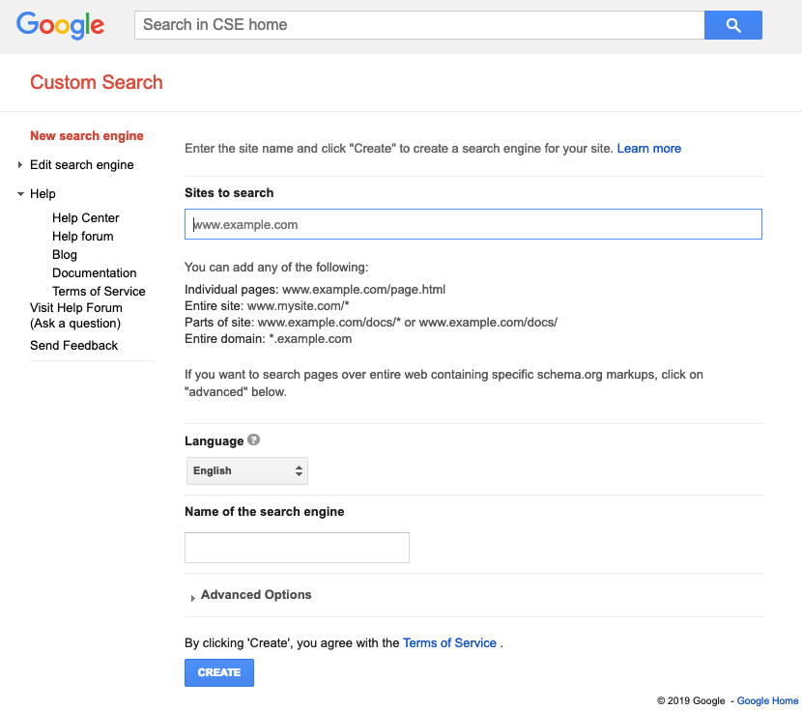
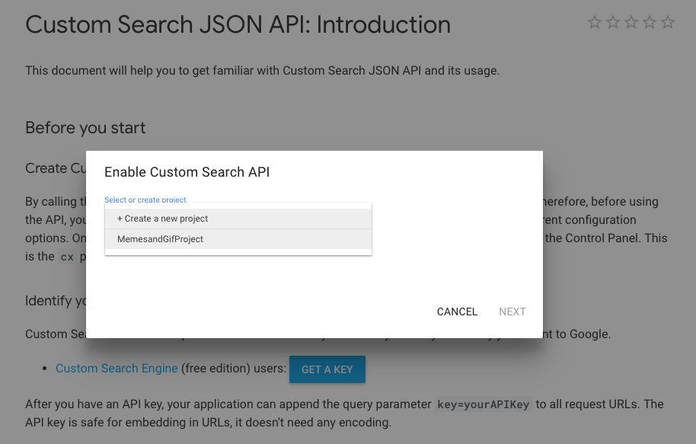
Meme proj breakdown,
API SETUP
SEARCH ENGINE SETUP

Slide 8
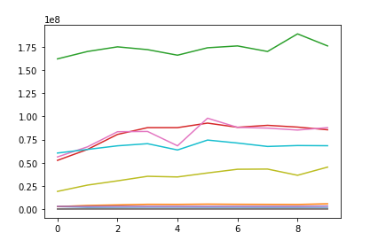
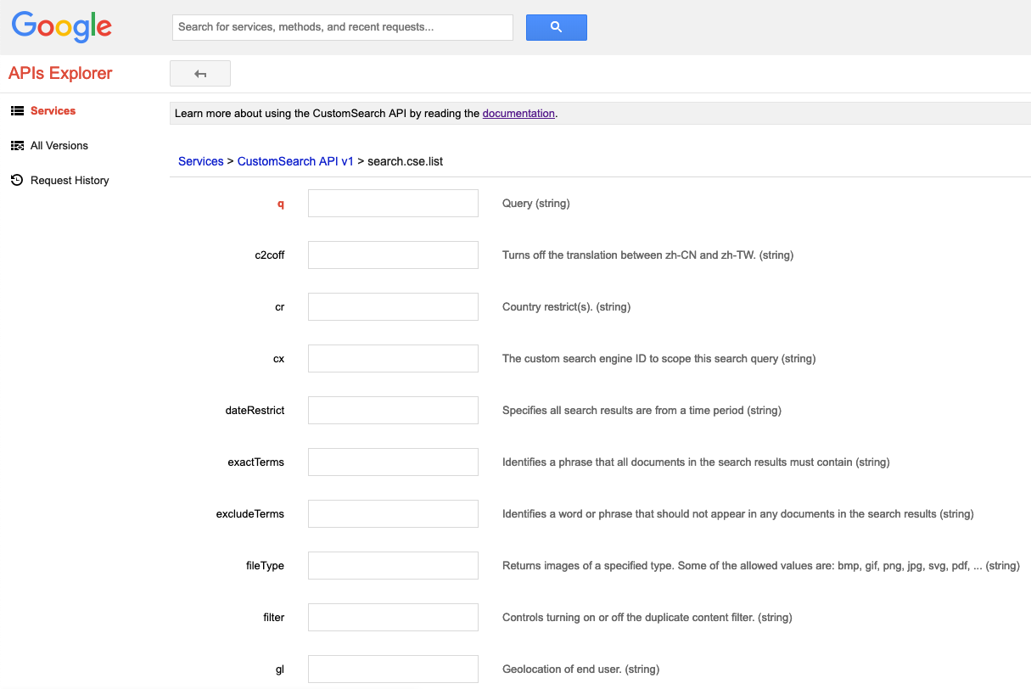
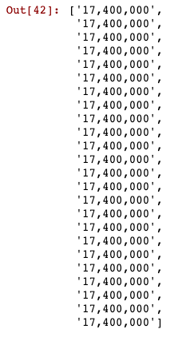
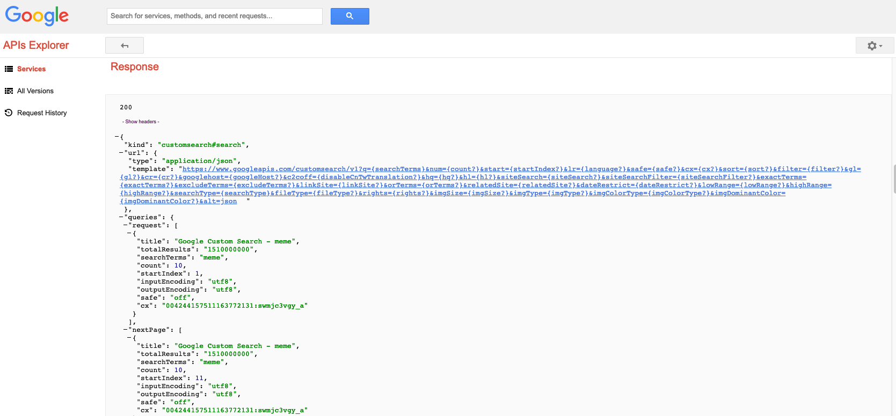
API CALL
DATA VALIDATION

Slide 9
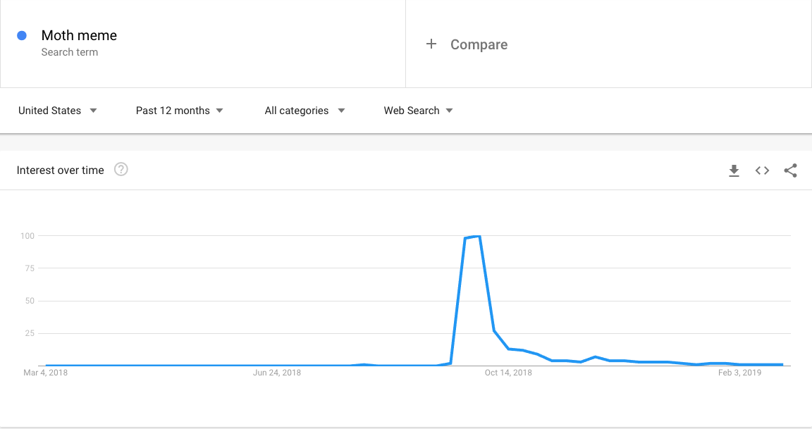
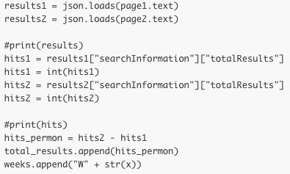
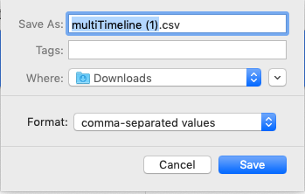
GOOGLE TRENDS
FORMULA REWRITE

Slide 10
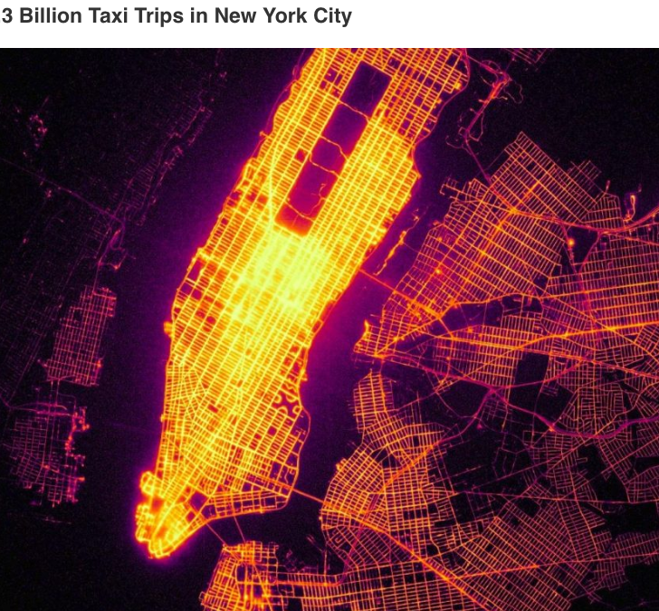
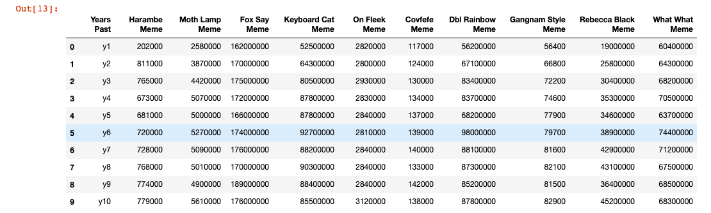
COMBINE DATA
VISUALIZE DATA
ACCEPT/DENY HYPOTHESIS
Meme’s will follow a product life cycle curve, and more specifically, have a period of exponential growth followed by a period of exponential decay.

Slide 11
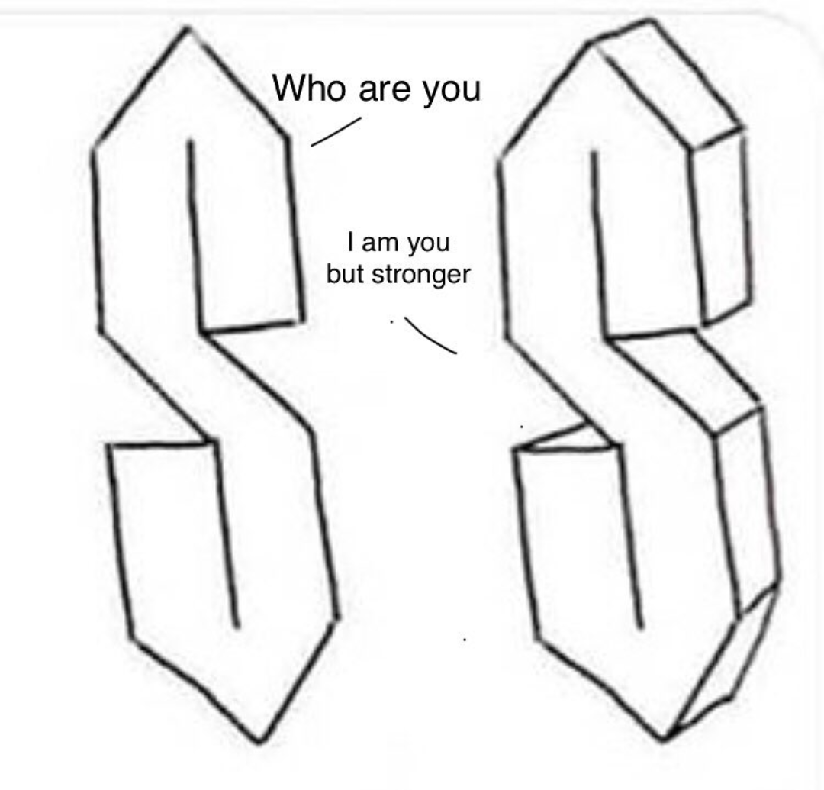
IMPORTANT STUFF

Slide 12
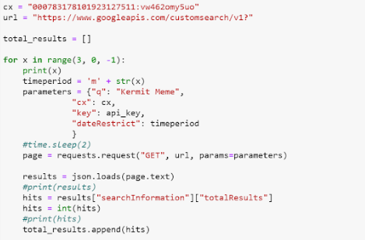
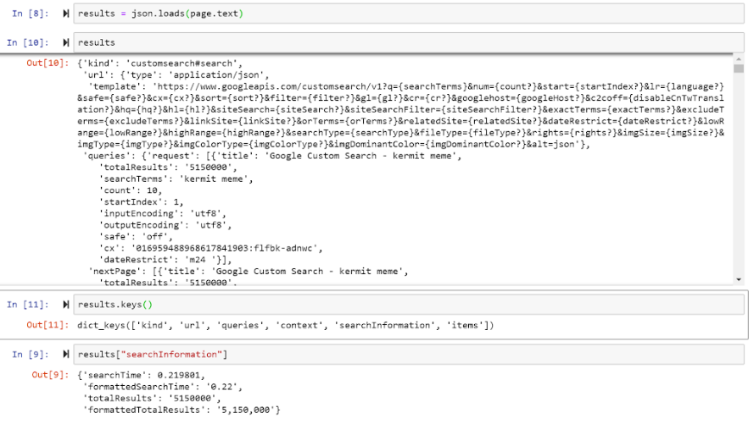
How we extracted the data

Slide 13
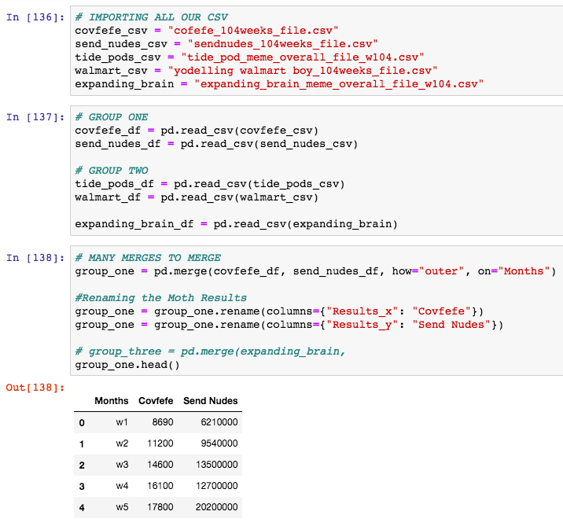
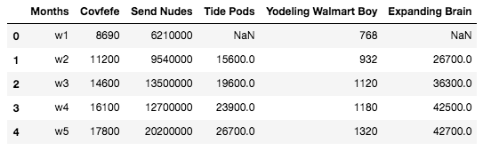
How we cleaned & combined data
Final Data Frame of most popular memes from 2017 - 2018

Slide 14
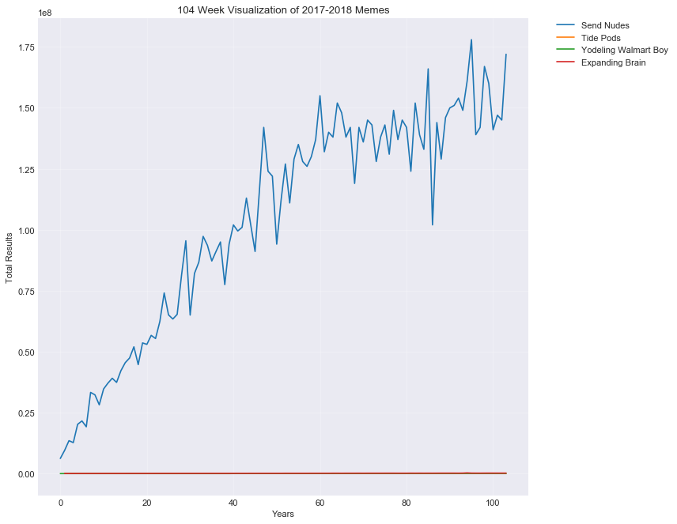
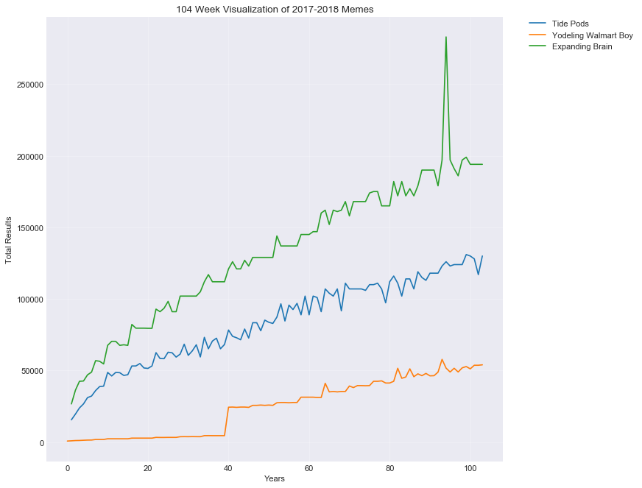
104 Week Visualization

Slide 15
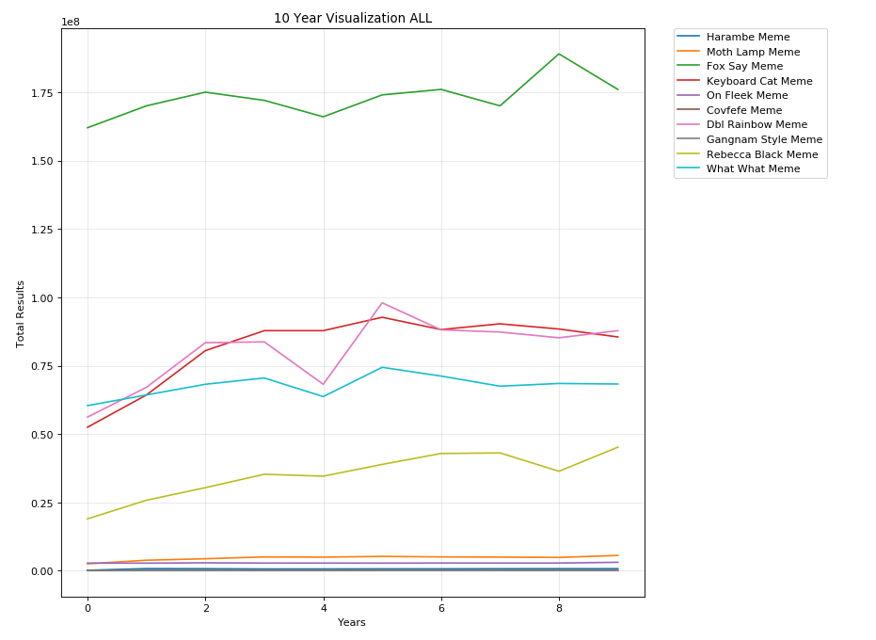
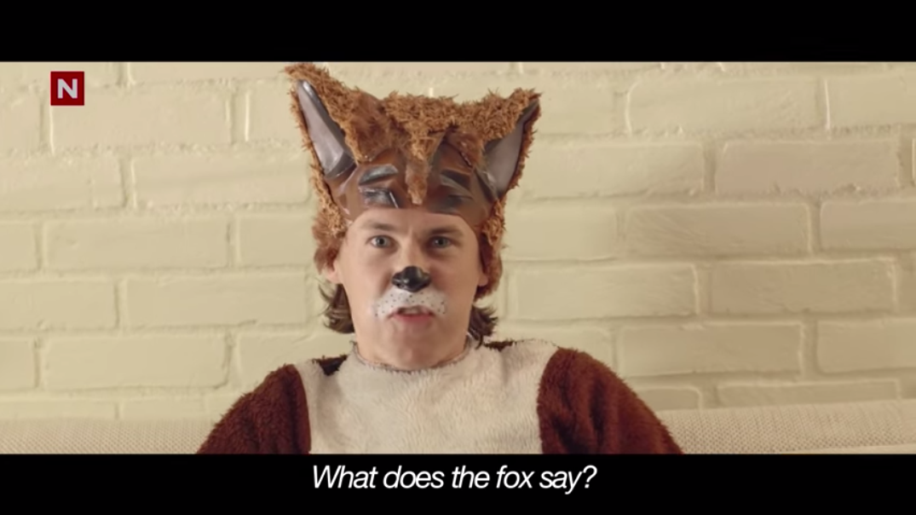
10 Year Visualization ALL

Slide 16
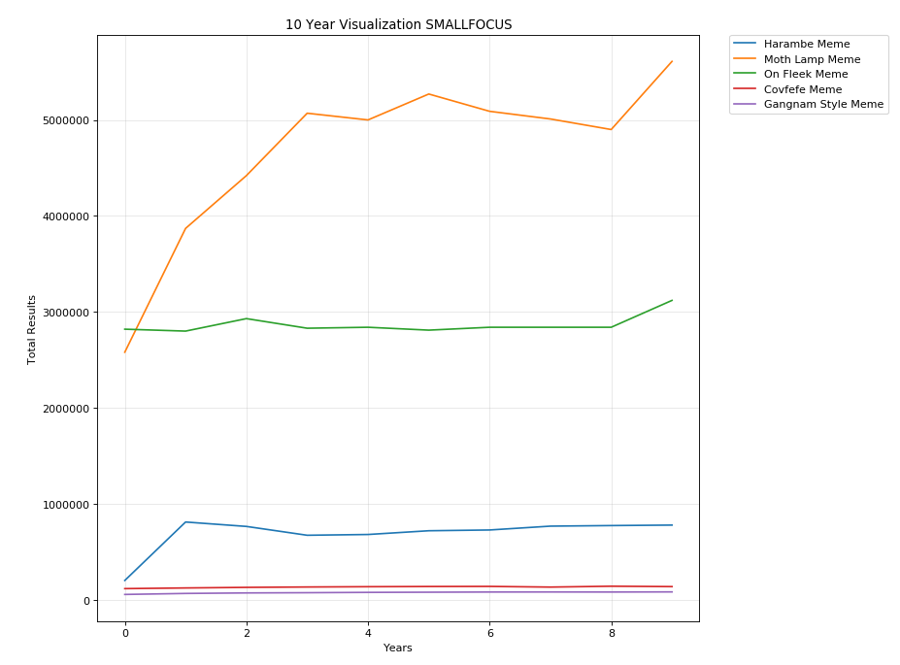


10 Year Visualization SMALLFOCUS

Slide 17
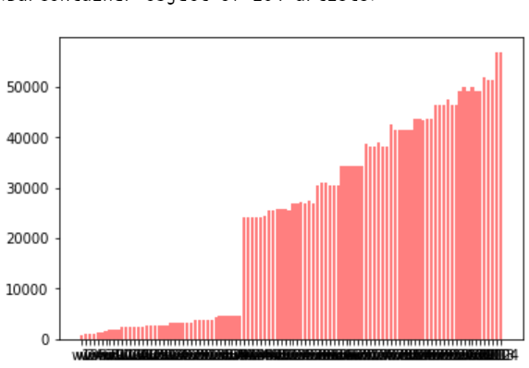
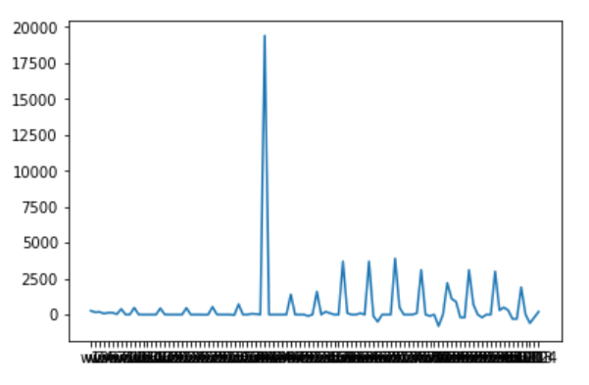
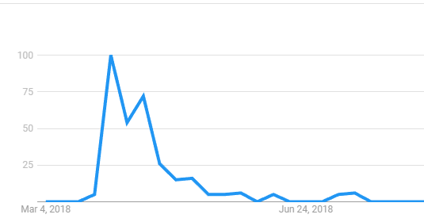
Interest vs Total Results Visualization EX #1
Good example:
yodelling walmart boy

Slide 18
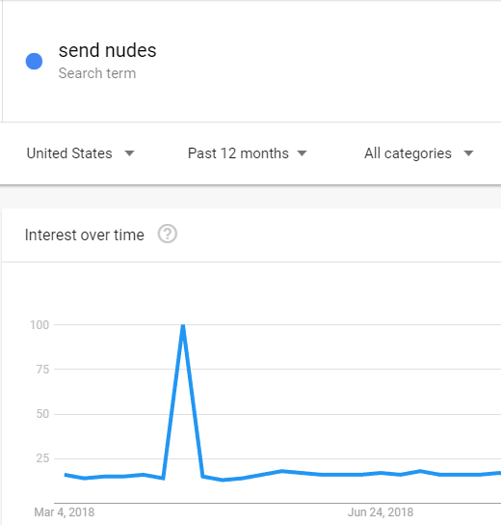
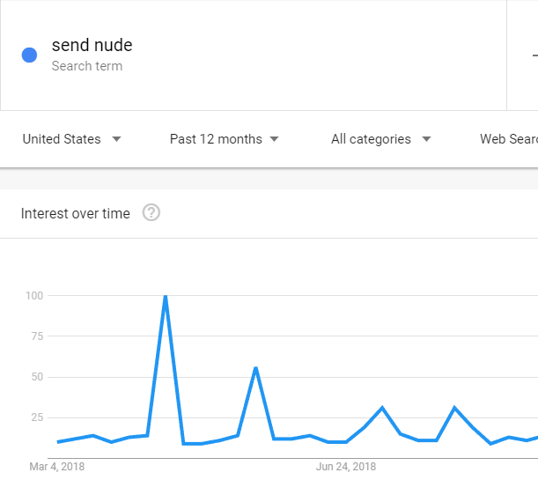
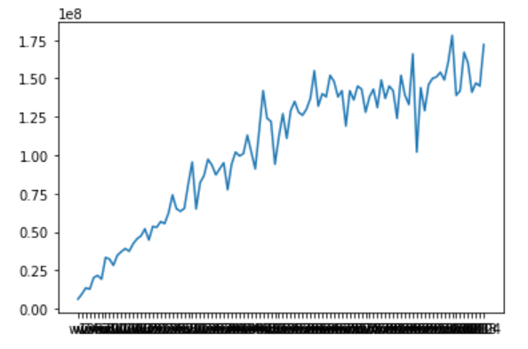
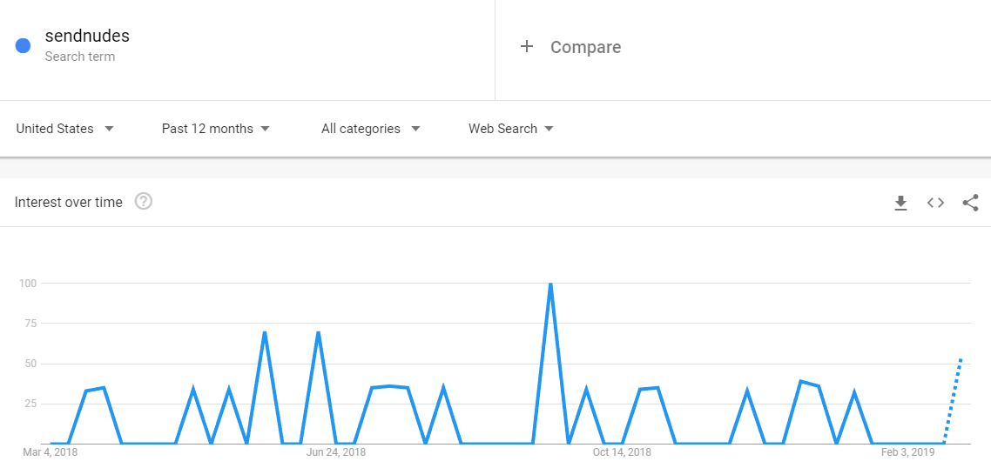
Interest vs Total Results Visualization EX #2
Bad example:
send nudes

Slide 19

Conclusions

Slide 20
THE MEME PRESENTATION CONCLUSION
PROJECT #1
“
We’re not sure
Group
Notes:
With the results we have we are confident that we do know there are periods with high growth and decay – even if they dont follow the life cycle. The data we have isnt enough to prove of disprove our hypothesis.

